Slide 1

Deloitte Pre Hire Training 2017
FOUNDATION TRAINING
Spring Core

Slide 2
Core Spring
Inversion Of Control

Slide 3
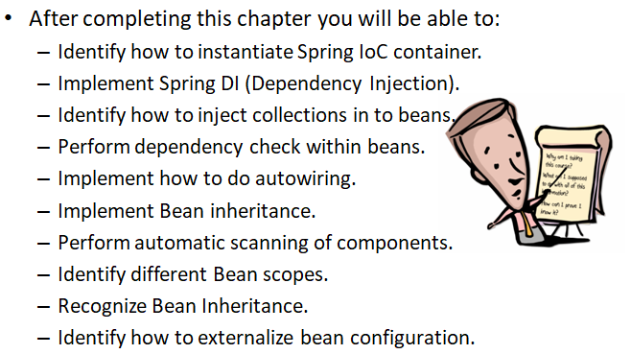
Objectives

Slide 4
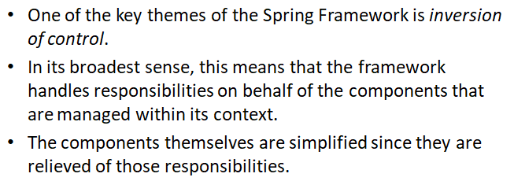
Inversion of Control

Slide 5
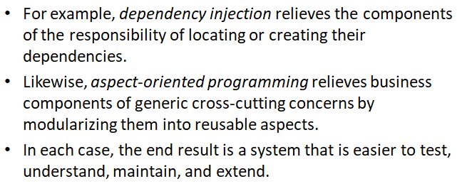
Inversion of Control

Slide 6
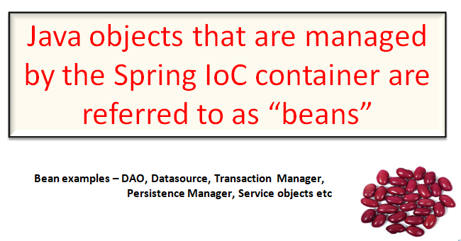
Spring Beans

Slide 7
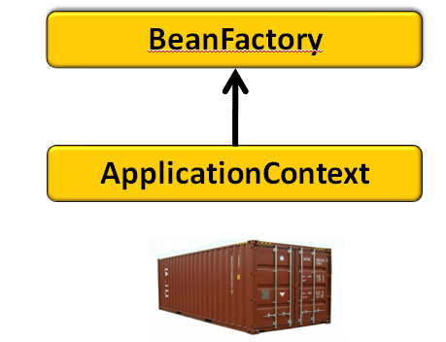
Spring IOC Container

Slide 8
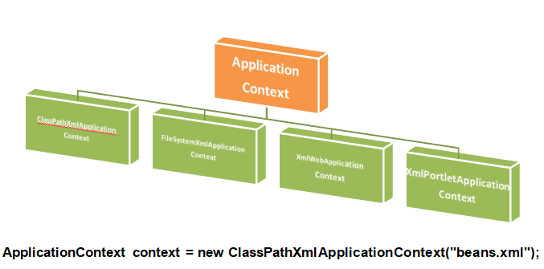
Instantiating an Application Context

Slide 9
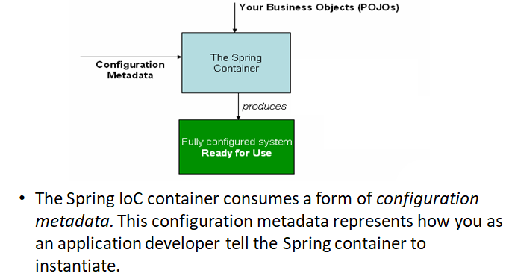
Instantiating an Application Context

Slide 10
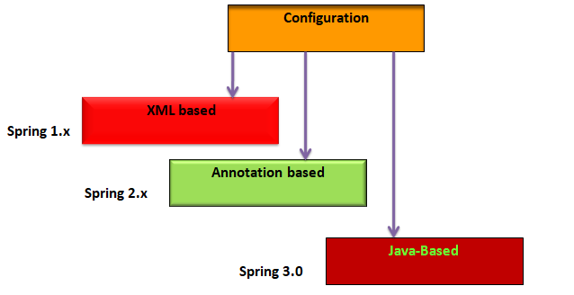
Configuration Metadata

Slide 11
Demo
Write sample code to explain Spring IOC container and how to get bean from the IOC container.

Slide 12
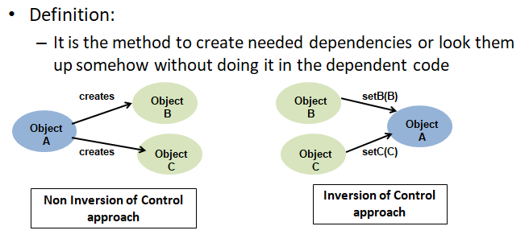
Dependency Injection(DI)

Slide 13
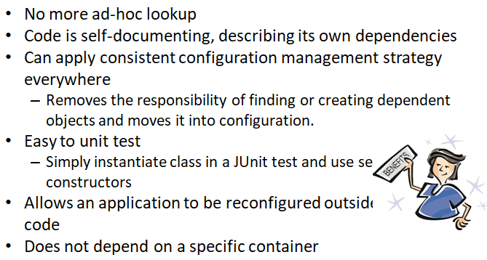
Benefits of DI

Slide 14
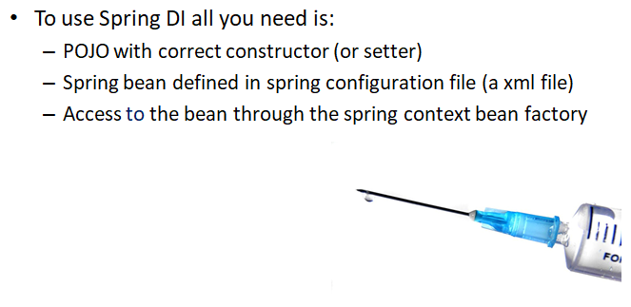
Spring DI

Slide 15
Demo
Write sample code to explain Spring DI using setter injection and constructor injection.
Write sample code to explain injecting bean reference using
Setter Injection
Constructor Injection

Slide 16
Configuring Collections
In Spring, collections can be easily configured using a group of inbuilt XML tags such as
<list></list>
<set></set>
<map></map>

Slide 17
Demo
Write sample code to explain the collection injection using <list>,<set> and <map>

Slide 18
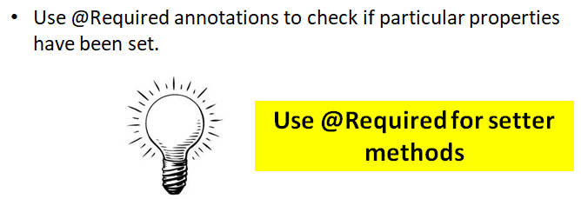
@Required Annotation

Slide 19
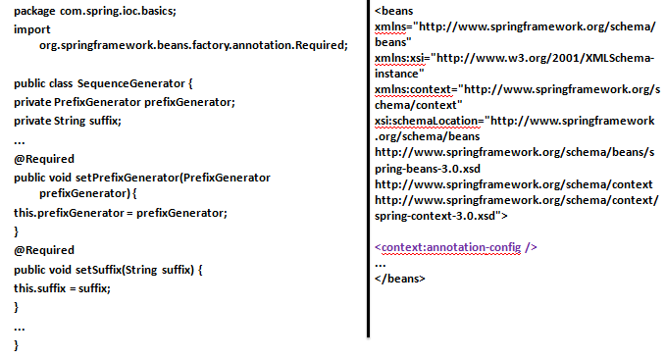
@Required Annotation

Slide 20
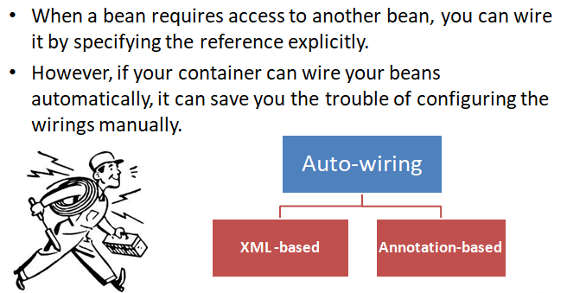
Auto-Wiring

Slide 21
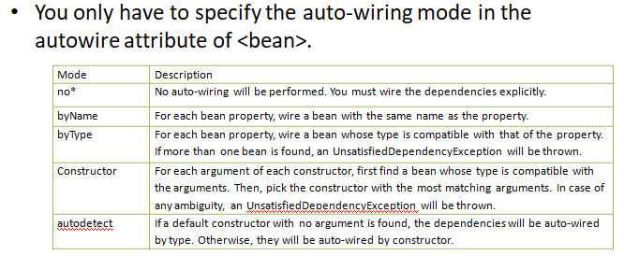
Auto-Wiring : XML Based

Slide 22
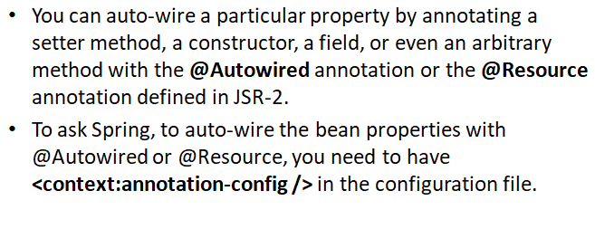
Auto-Wiring : Annotation Based

Slide 23
Demo
Write sample code to explain the auto wiring using byName using XML configuration and using Annotation.

Slide 24
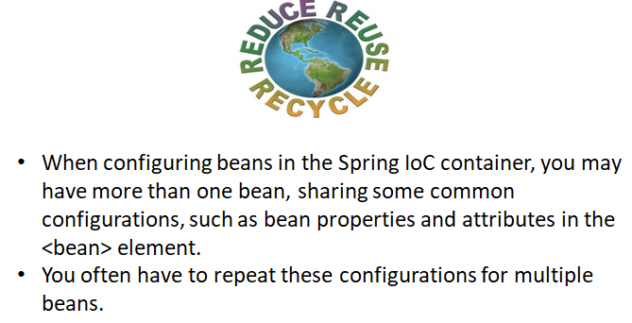
Inheriting Bean Configuration

Slide 25
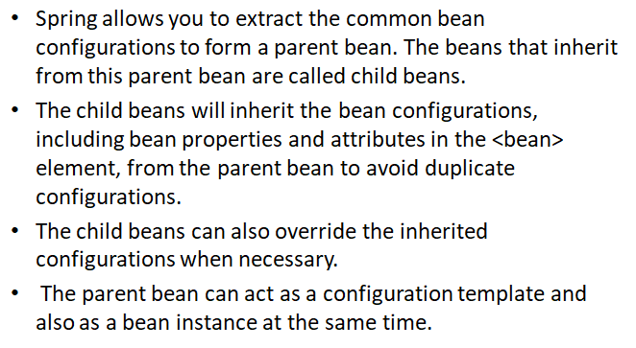
Inheriting Bean Configuration

Slide 26
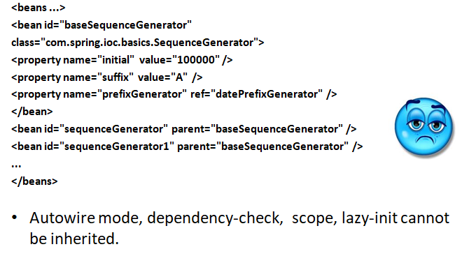
Inheriting Bean Configuration

Slide 27
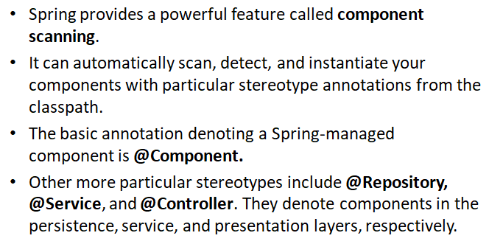
Scanning Components from the Classpath

Slide 28
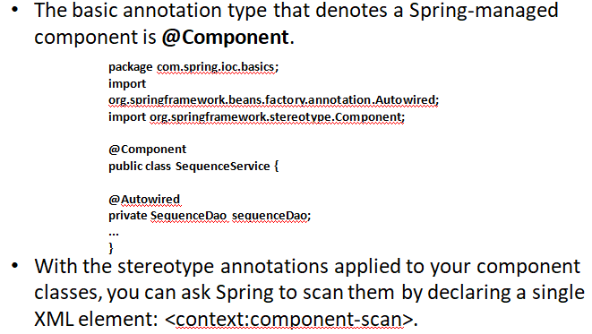
@Component Annotation

Slide 29
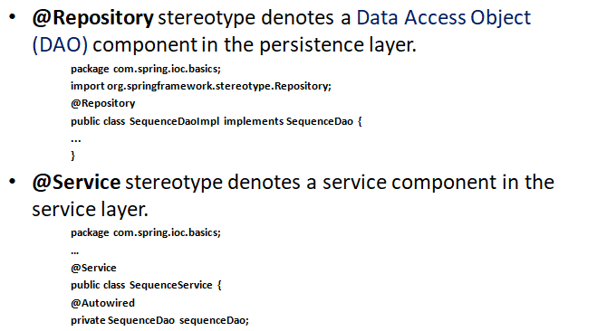
@Repository and @Service

Slide 30
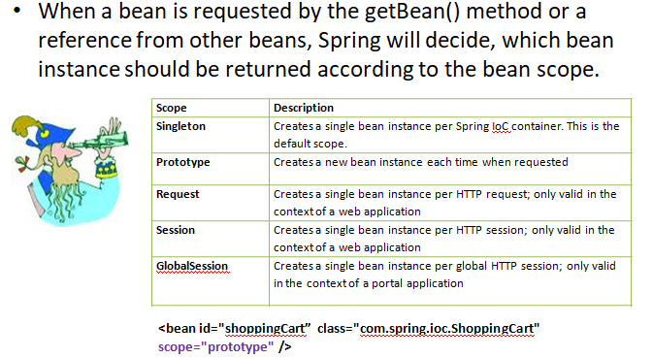
Beans Scope

Slide 31
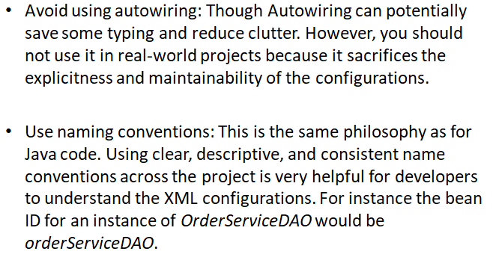
Best Practices and Industry Standards

Slide 32
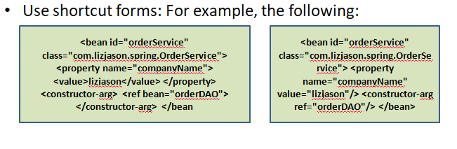
Best Practices and Industry Standards

Slide 33
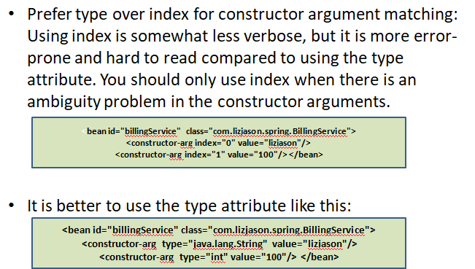
Best Practices and Industry Standards

Slide 34
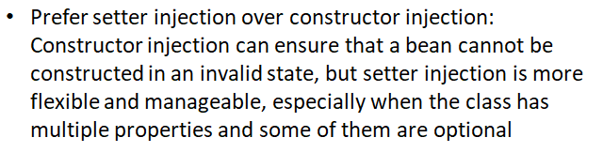
Best Practices and Industry Standards

Slide 35
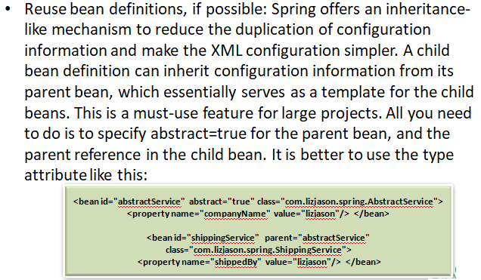
Best Practices and Industry Standards

Slide 36
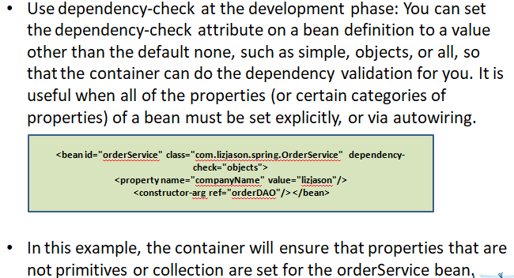
Best Practices and Industry Standards

Slide 37
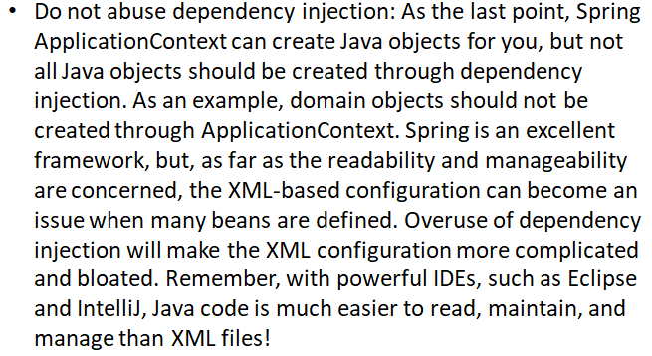
Best Practices and Industry Standards

